Slide 1
Mission Read to a Child

Slide 2

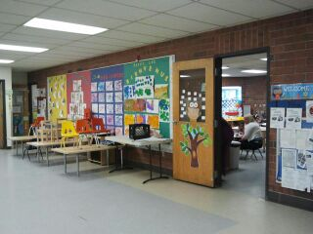
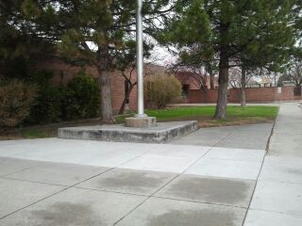
Head Start

Slide 3
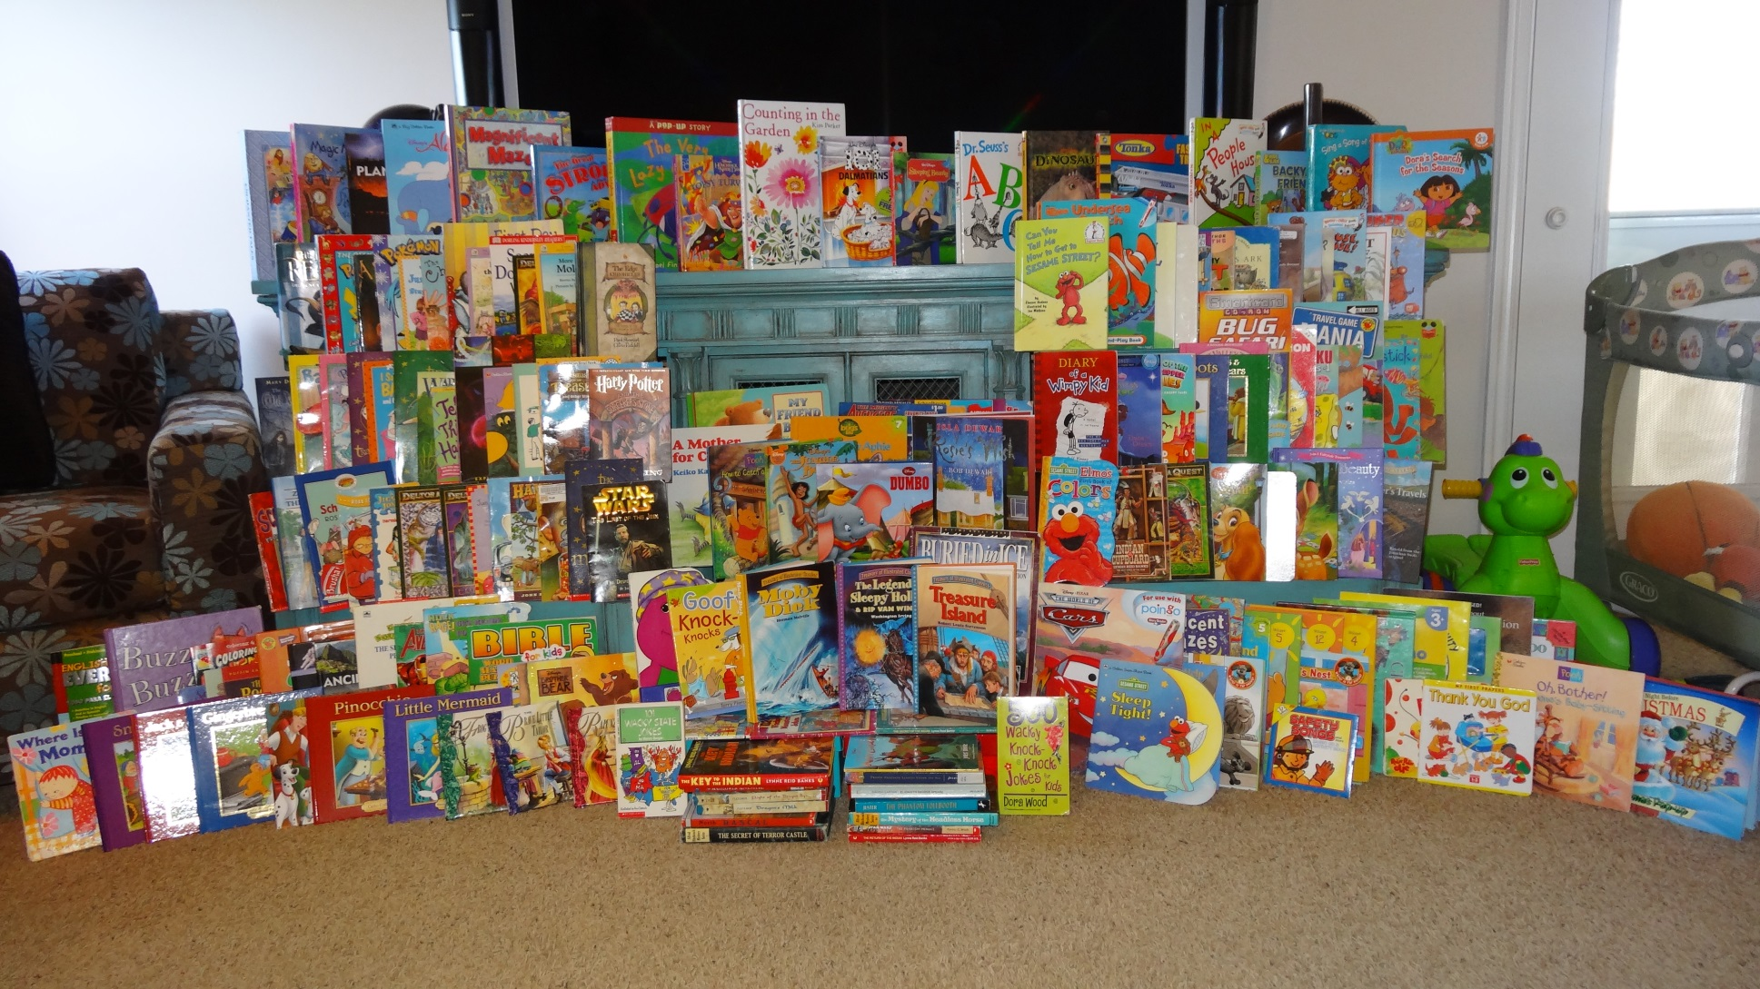
Collected 200 Book!

Slide 4
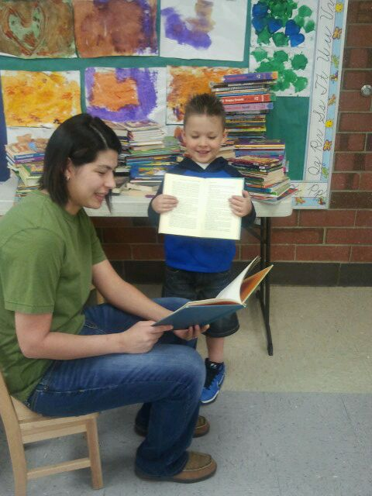
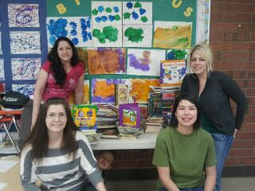
Trip to Head Start

Slide 5
Executive Summary
Reading and writing begin in the home before children ever start to attend school
We are committed to maximizing the learning potential of children who are eager to learn
Of 102 people who were sampled,
75% of our respondents stated that
Reading is for both “fun” and for
“learning”
We found that there was a correlation
between those that said if more books
were available to them, they would
read to their children more often

Slide 6

Executive Summary
Our mission was to access books through different channels who were willing to donate
We then turn those books over to families to enable them to sustain a healthy reading environment
We do believe that this project will
serve a population of under privileged
families and that getting their parents
involved will encourage a new vision
of what the power of reading can do

Slide 7
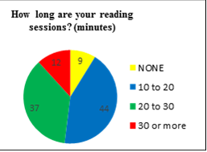
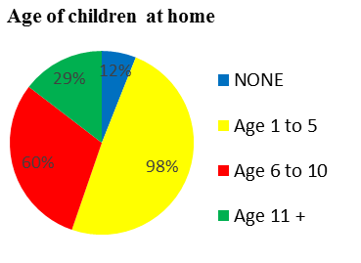

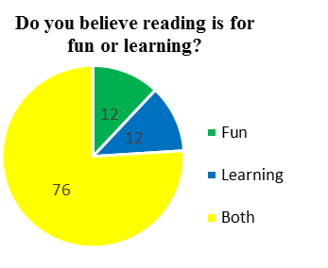

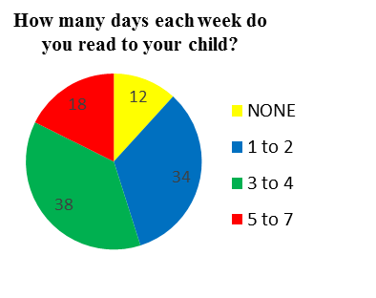
Executive Summary
You can see it doesn’t matter how young or old, children love to read!

Slide 8
Analysis of Findings

Slide 9
Literacy statics
80% of preschool and after-school programs serving low-income populations have no age-appropriate books for their children.
The most successful way to improve the reading achievement of low-income children is to increase their access to print.
Creating a steady stream of new, age-appropriate books has been shown to nearly triple interest in reading within months.
By the age of 2, children who are read to regularly display greater language comprehension, larger vocabularies, and higher cognitive skills than their peers.

Slide 10
The Early Childhood Longitudinal Study found that in the spring of 2000, the children who were read to at least three times a week by a family member were almost twice as likely to score in the top 25% in the reading compared to children who were read to less than 3 times a week.
These early positive experiences with reading serve as a stepping stone for further literacy development. Children will see reading as an enjoyable process and become familiar with the skills that make them ‘‘preschool ready’’. Having books and resources readily available will allow them easy opportunities to read and practice their skills at home.

Slide 11
Questionnaire Results

Slide 12
Conclusion & Recommend
Early exposure to reading provides children with knowledge and literacy skills which are critical for the development of a strong academic and social foundation.
80% of preschool and after-school programs serving low-income populations have no age-appropriate books for their children.

Slide 13
Conclusion & Recommend
Ten good reasons to read to your child:
* A stronger relationship with you.
* Academic excellence.
* Basic speech skills.
* The basics of how to read a book.
* Better communications skills.
* Mastery of language.
* More logical thinking skills
* Acclamation to new experiences.
* Enhanced concentration and discipline.
* The knowledge that reading is fun!

Slide 14
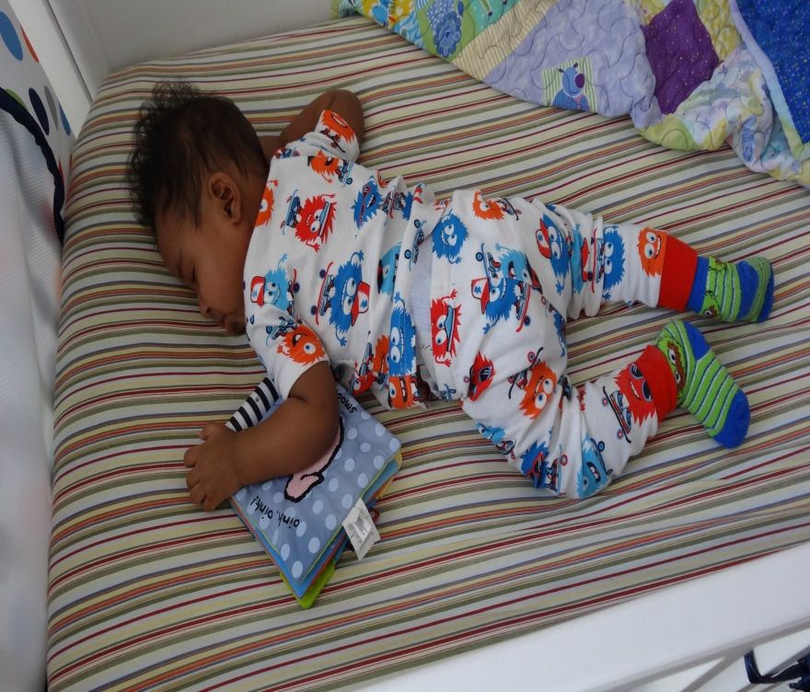
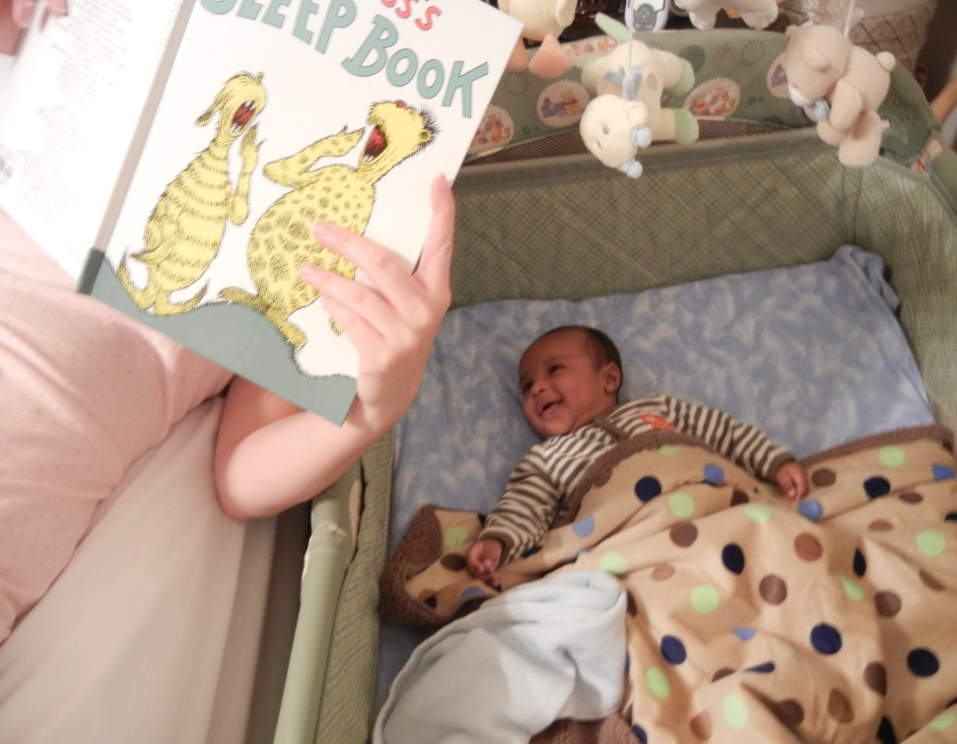
Thank you for your time…….

